Slide 1
SHYAMA PRASAD MUKHERJI RURBAN MISSION (SPMRM)
Kottayam – Mangattidam cluster (Phase 1)
Kannur district
STATE - KERALA

Slide 2
Physical Progress report (Cluster Level)
Phase I | Total No. of Work |  |  |  | Completed |  |  |  | Ongoing |  |  |  | Not Started
Name of Clusters | Convergence | Both* | CGF | Total | Convergence | Both* | CGF | Total | Convergence | Both* | CGF | Total | Convergence | Both* | CGF | Total
Vellanad - Aryanad Cluster | 32 | 9 | 62 | 103 | 31 | 3 | 36 | 70 | 1 | 4 | 22 | 27 | 0 | 2 | 4 | 6
Puthenvelikkara - Kunnukara Cluster | 18 | 5 | 26 | 49 | 18 | 0 | 2 | 20 | 0 | 5 | 16 | 21 | 0 | 0 | 8 | 8
Mangattidam - Kottayam Cluster | 31 | 19 | 19 | 69 | 12 | 4 | 7 | 23 | 16 | 14 | 10 | 40 | 3 | 1 | 2 | 6
Puthupally - Manarcadu Cluster | 15 | 27 | 18 | 60 | 4 | 5 | 4 | 13 | 5 | 8 | 7 | 20 | 7 | 14 | 6 | 27
Total | 96 | 60 | 125 | 281 | 65 | 12 | 48 | 125 | 21 | 30 | 55 | 106 | 11 | 18 | 21 | 50

Slide 3
Financial Progress Report of Phase I (Cluster Level) (In Crores)
Phase I | Project Cost |  |  | Fund Received |  |  | Expenditure
Name of Clusters | Convergence | CGF | Total | Convergence | CGF | Total | Convergence | CGF | Total
Vellanad - Aryanad Cluster | 134.37 | 30.00 | 164.37 | 39.16 | 14.56 | 53.6 | 39.16 | 12.61 | 51.77
Puthenvelikkara - Kunnukara Cluster | 172.89 | 30.00 | 202.89 | 167.69 | 17.01 | 184.70 | 167.04 | 12.00 | 179.04
Mangattidam - Kottayam Cluster | 96.01 | 30.00 | 126.01 | 56.84 | 23.99 | 80.83 | 56.84 | 23.70 | 80.54
Puthupally - Manarcadu Cluster | 121.52 | 30.00 | 151.52 | 65.45 | 16.41 | 81.87 | 65.44 | 13.84 | 79.28

Slide 4
Outcome
The implementation of NRuM in Kerala is facilitating the improvement of infrastructure for the economic and social development of the clusters.
New employment opportunities have been created.
Agricultural production is improving.
Educational and Health care institutions are upgraded to provide good services to the citizens.
Supply of piped drinking water supply and the provision of complete electrification will improve the living standard of the people in these clusters.
The skill development activities and training is providing new hopes to the youth of these areas.

Slide 5
MANGATTIDAM GRAMA PANCHAYATH
KOTTAYAM GRAMA PANCHAYATH
Area | 33.09 Sq.Km
No. of Wards | 19
Total Population | 34652
Male | 16357
Female | 18295
Area | 8.43 Sq.Km
No. of Wards | 14
Total Population | 19176
Male | 8813
Female | 10363
(Amounts in Crore)
Total Investment as per DPR : 126.019
Convergence : 96.019
CGF : 30.00

Slide 6
PROGRESS OF CLUSTER
Item | Expenditure (Crores)
Convergence | 56.84
CGF | 23.70
Total | 80.54
Works | Status
Total No. | 69
Completed | 23
Ongoing | 40
Not Started | 6

Slide 7
Glimpses from Kottayam Grama Panchayat

Slide 8
Kottayam Chira Rennovation (Convergence amount-4 crore)

Slide 9
Mangalottchal Swimming Pool (CGF-32 Lakhs)

Slide 10
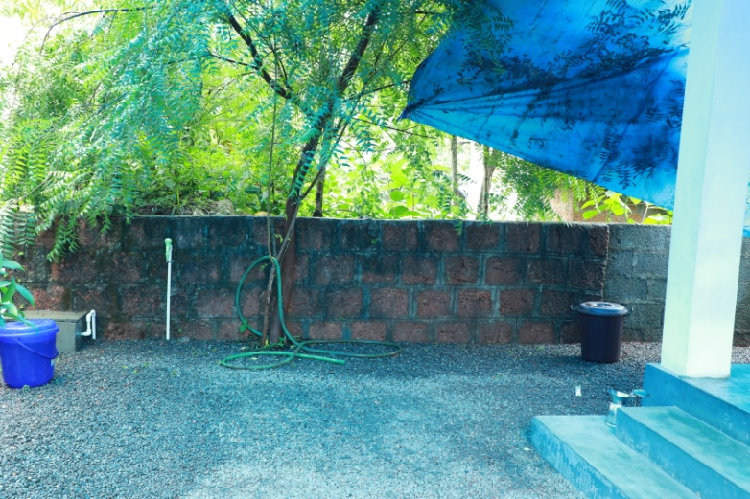
Piped water connection for 3815 households (CGF-2.48 crore)

Slide 11
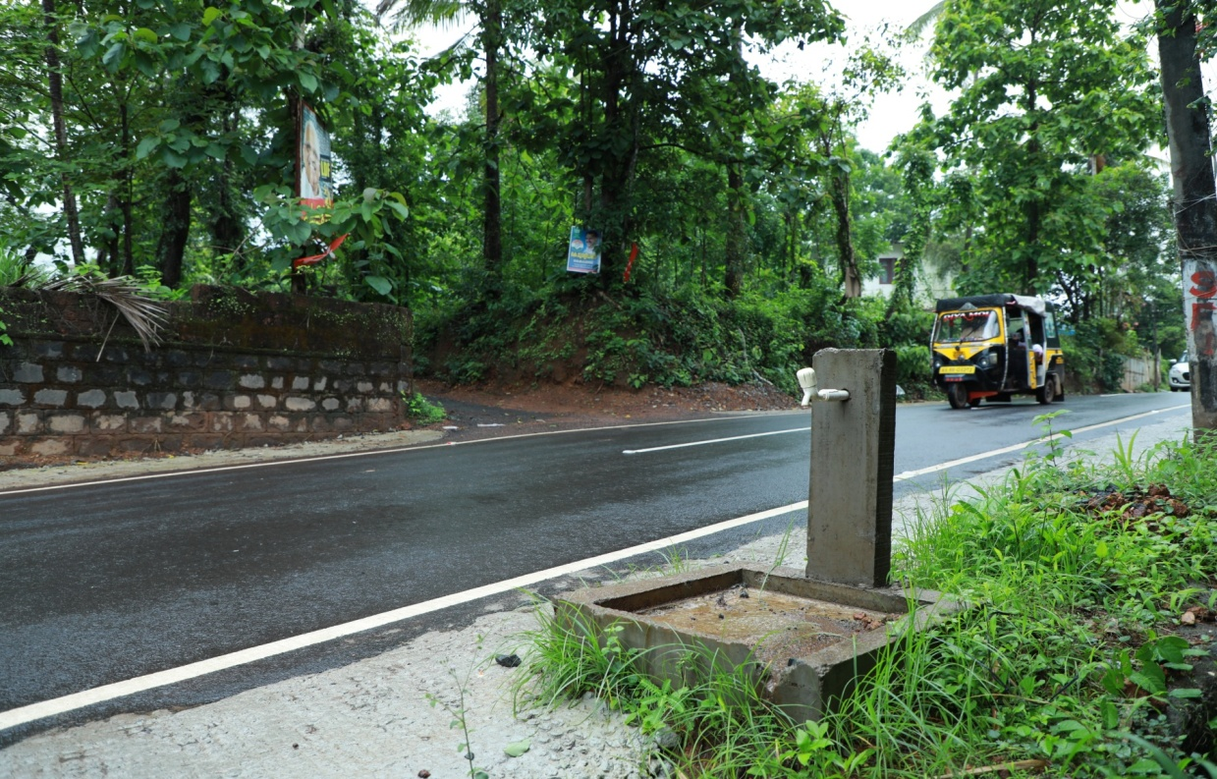
Public Taps connections - 42

Slide 12
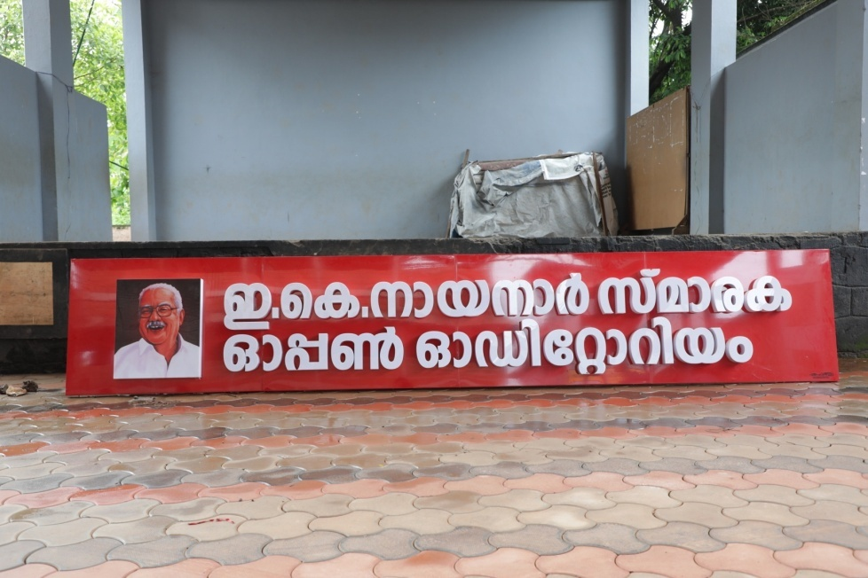
Open auditorium in school CGF – 30 Lakh

Slide 13
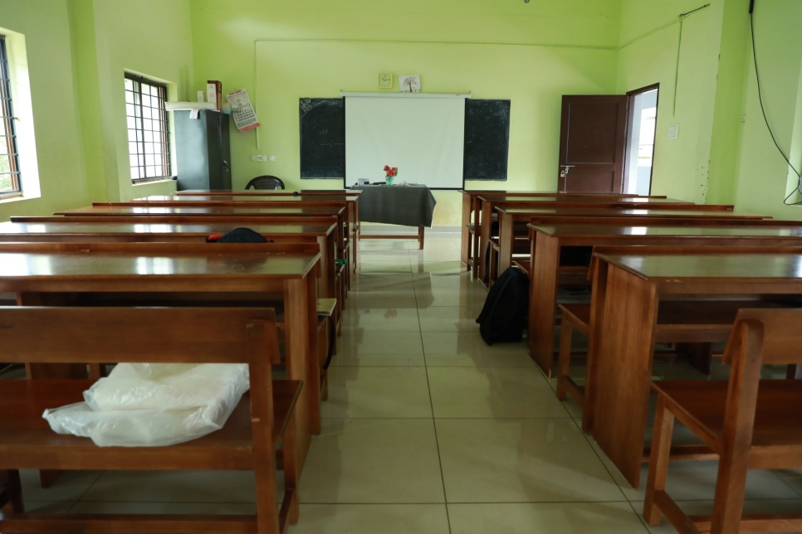
30 Classrooms Renovation (CGF-30 Lakhs)

Slide 14
Shuttle Curt in school (CGF 5 Lakhs)

Slide 15
Dinning Hall in school (CGF- 5 Lakhs)

Slide 16
School Passage (5 Lakhs)

Slide 17
Water Purifiers in all Blocks in school (5 lakhs)

Slide 18
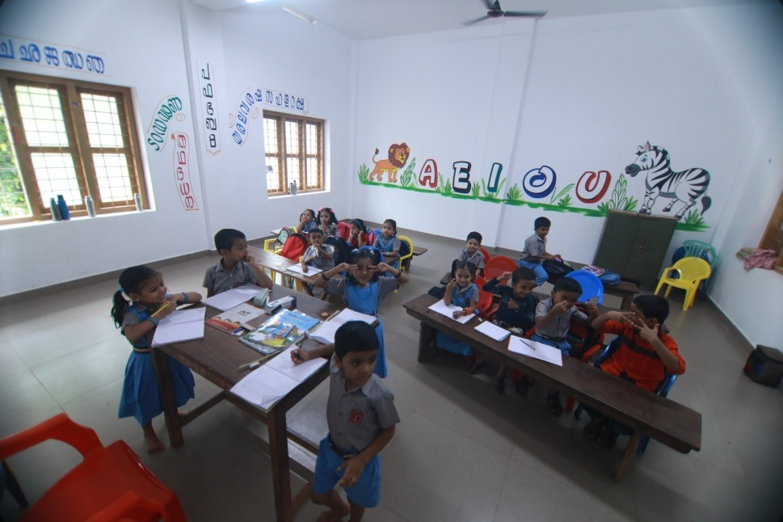
LKG Class room renovation and Science Lab renovation (12 lakhs)

Slide 19
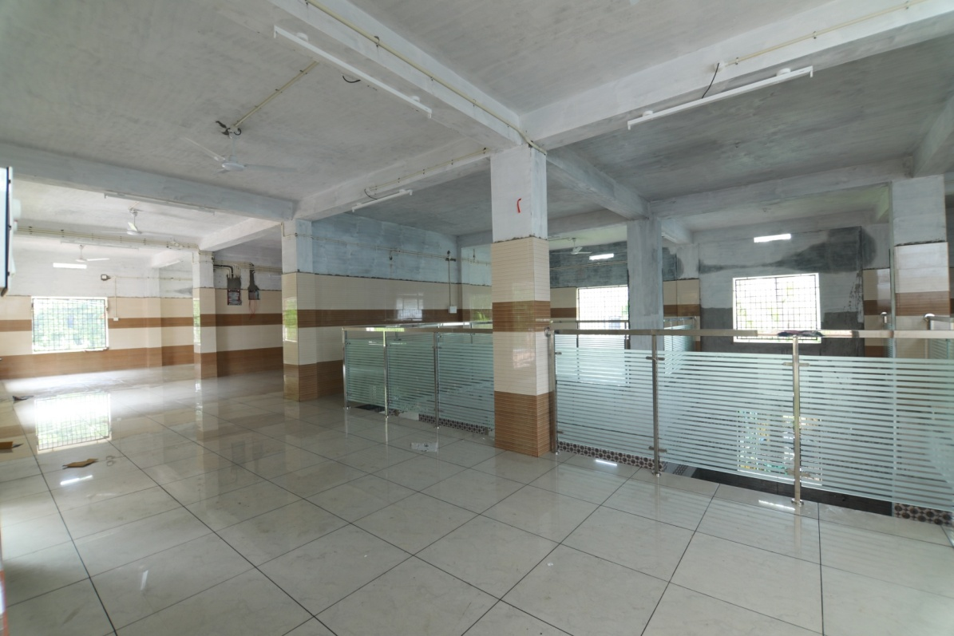

Slide 20
Online Exam center CGF 40 lakhs

Slide 21
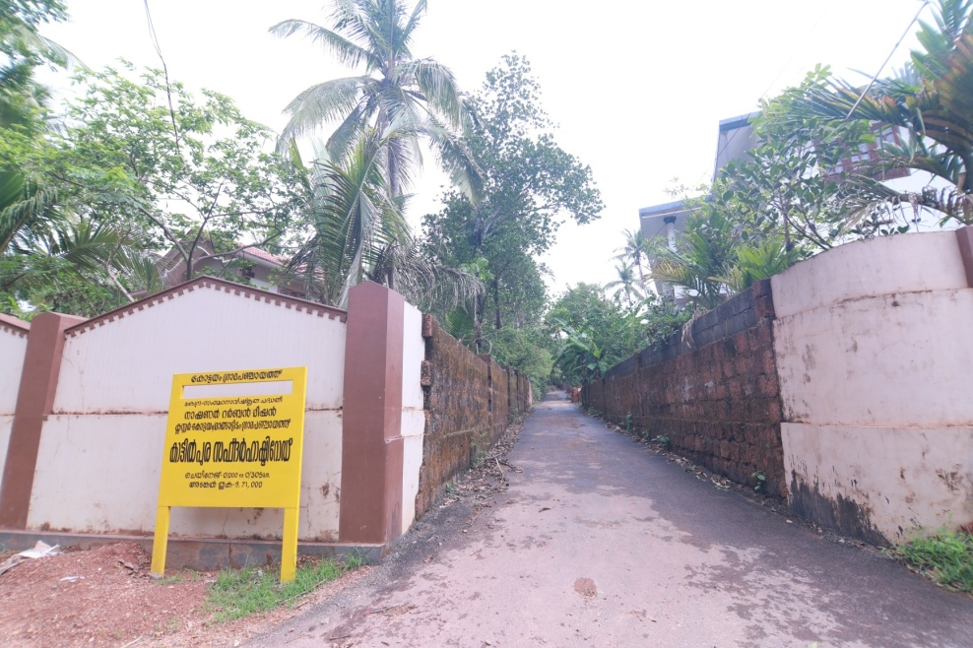
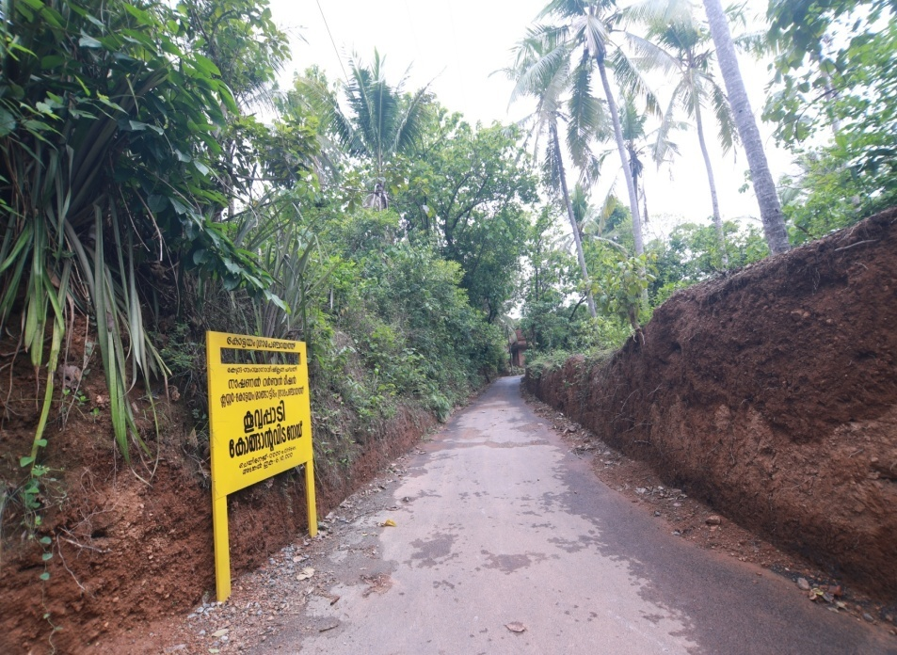
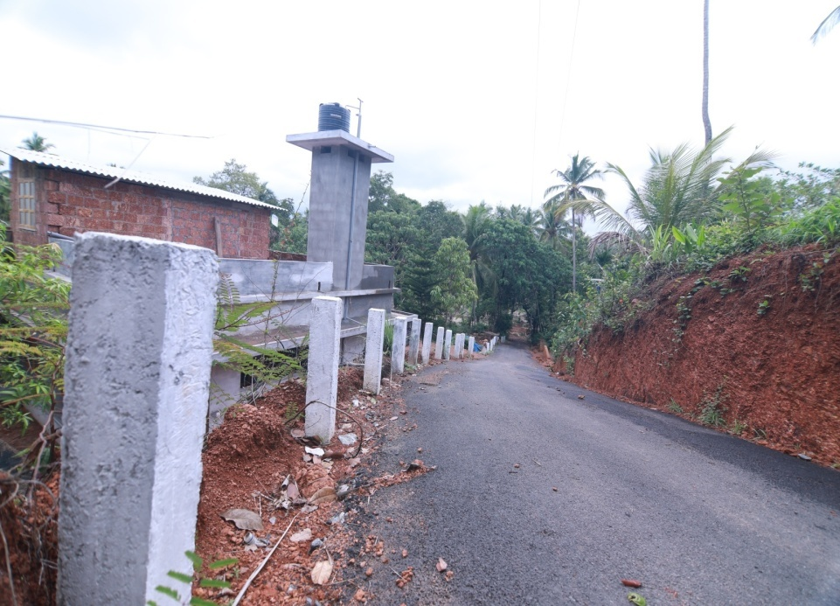
New Village Roads (Rs. 236 Lakhs)

Slide 22
GP- To –GP Road(Rs. 122.215 lakhs)

Slide 23
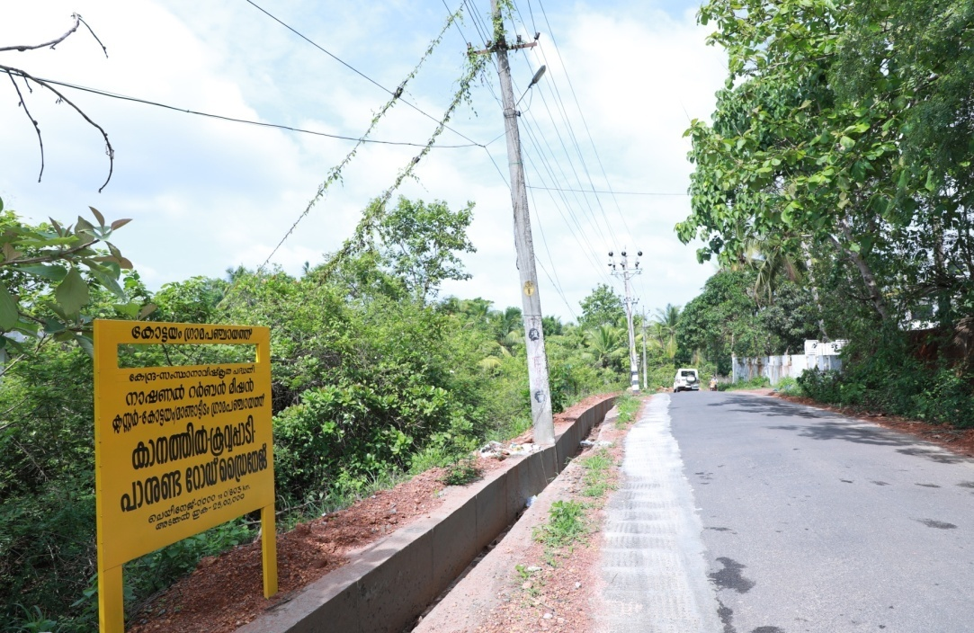
Construction of Drainage (Rs. 231.26 Lakhs)

Slide 24
Gram Kendra CGF 14 lakhs

Slide 25
Adolescent center 3 Nos (Rs 35 lakhs)

Slide 26
Glimpses from Mangattidam Grama Panchayat

Slide 27
Kiosk facility in GP front Office
CGF – 1.5 lakh

Slide 28
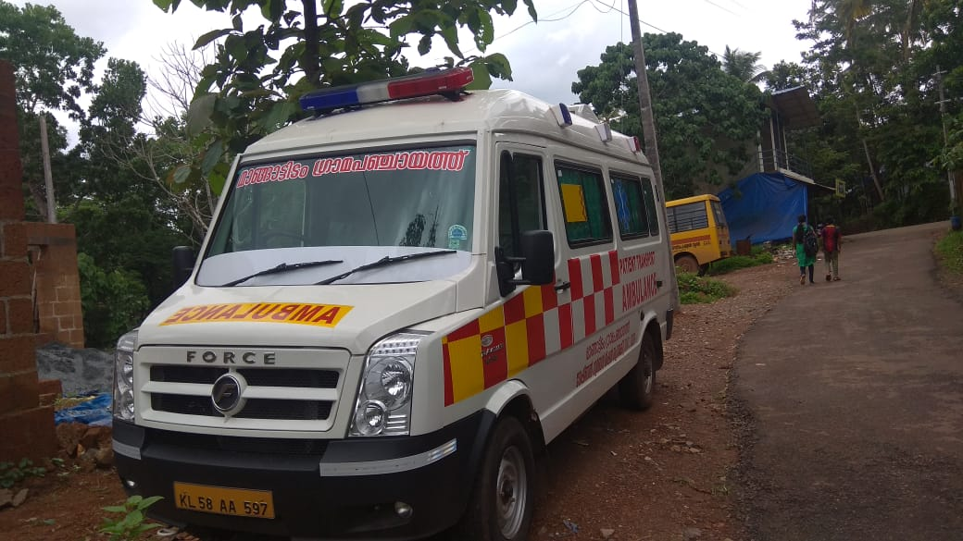
Fully equipped Mobile Health Unit Total project cost – 84 lakh (CGF 82 lakh)

Slide 29
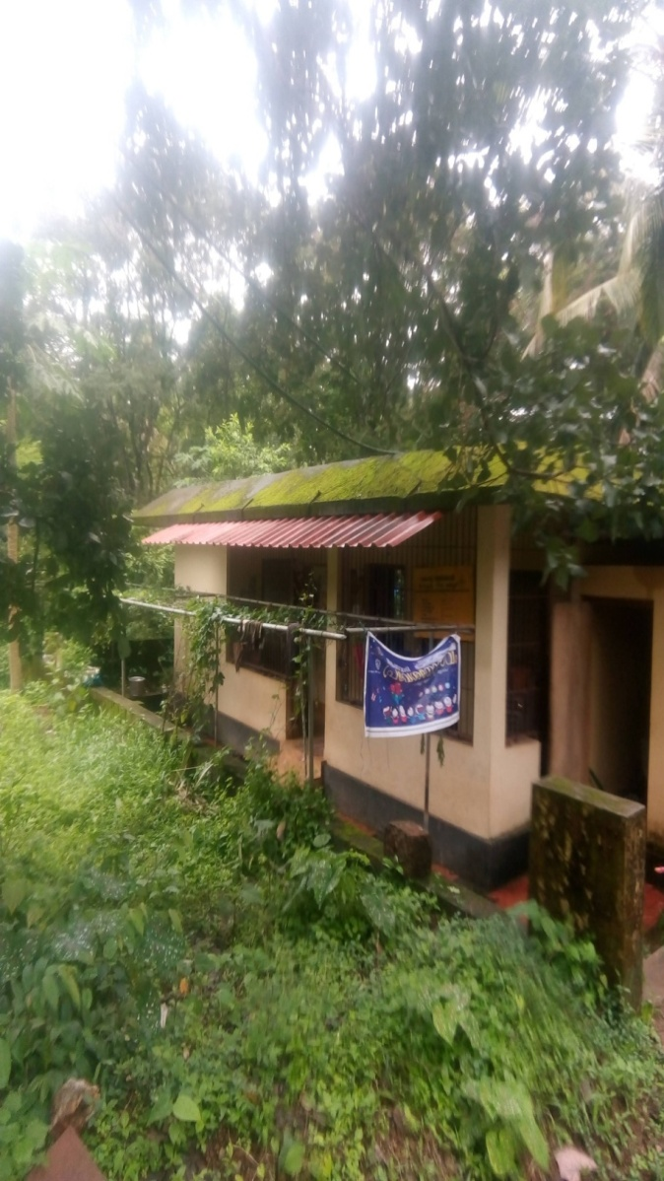
Construction and Improvement of Upstairs Building as counselling Centre for Teenage Girls (6 nos)
Total project cost – 86.34 lakh ( CGF – 80 lakh)
After
Before

Slide 30
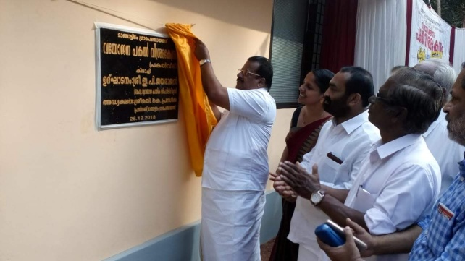
Day Care Centre Total project cost- 9 lakh (CGF – 8 lakh )

Slide 31
Marketing Center at Kaitheri total project cost – 30 lakh (CGF – 25 lakh)

Slide 32
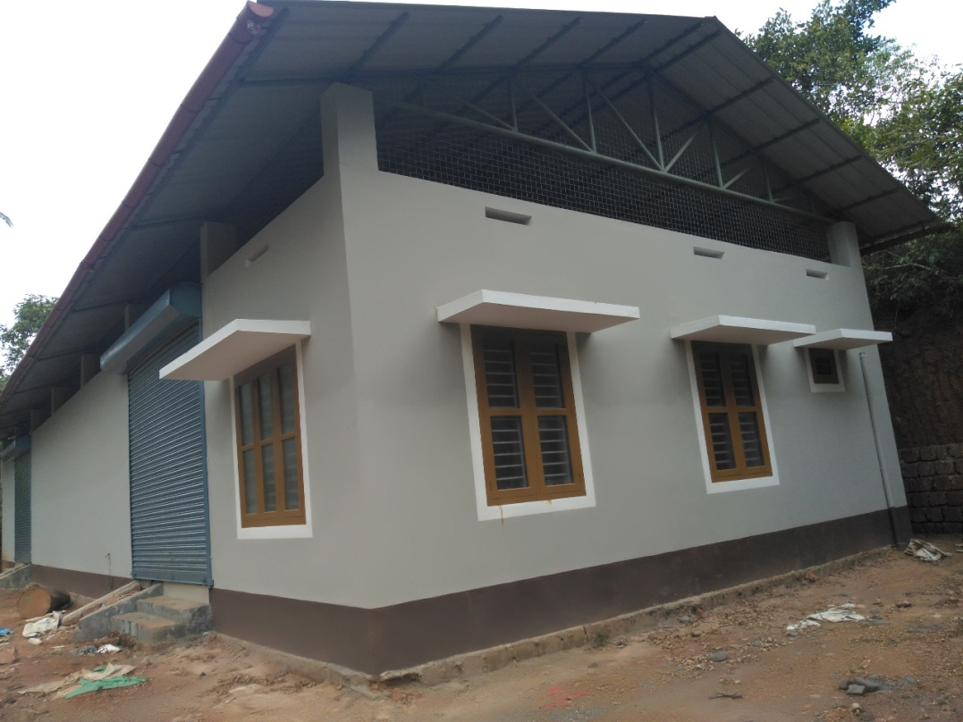
Plastic E Waste Management Unit
Total project cost- 36.76 lakh
CGF – 16 lakh

Slide 33
Construction of Building For Veterinary Sub centre Total project cost 10 lakh (CGF - 8 lakh )

Slide 34
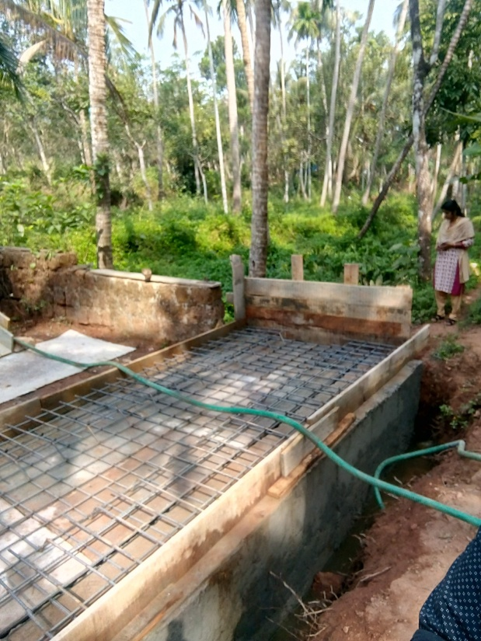
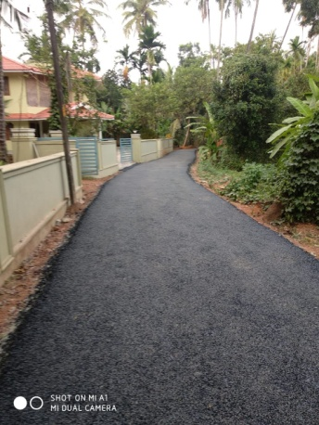
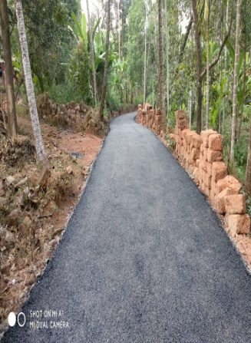
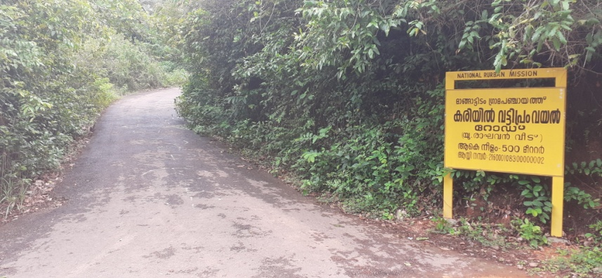
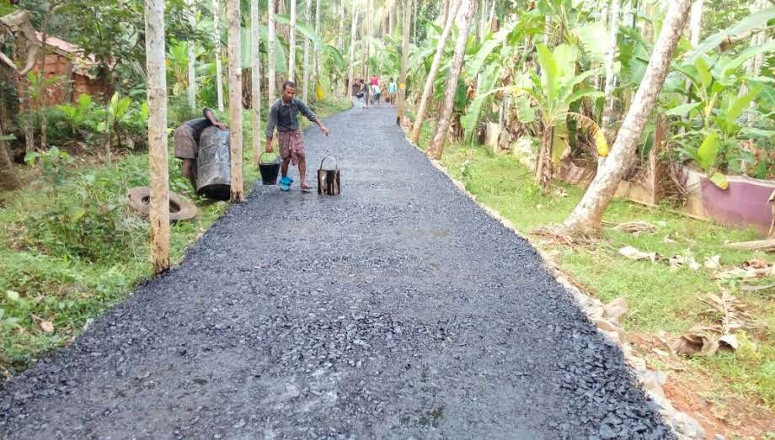
Construction of Village roads

Slide 35
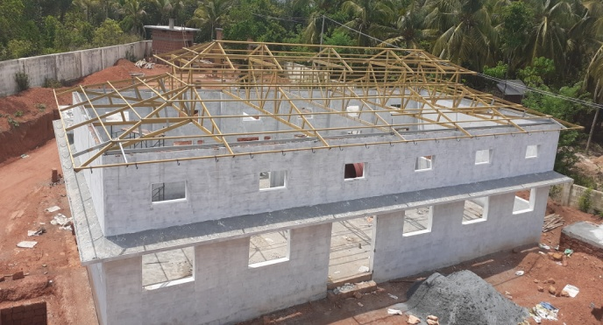
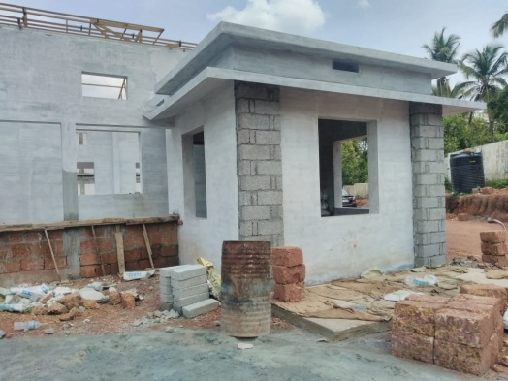
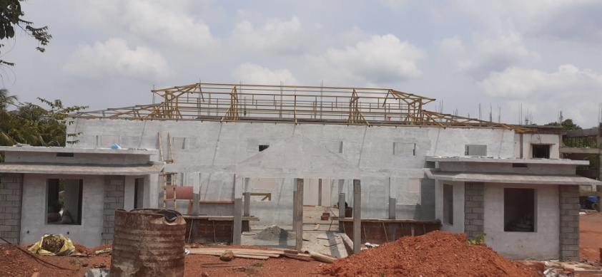
Proposed Gas Crematorium

Slide 36
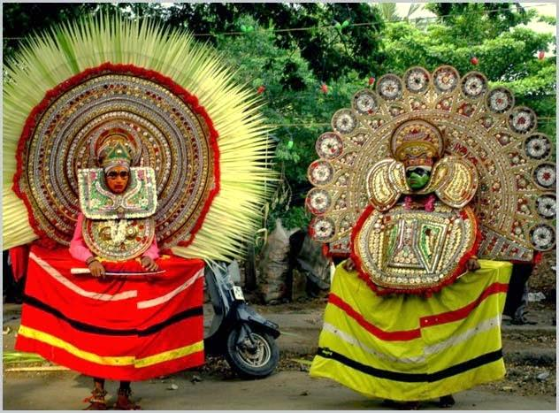
THANK YOU

